Slide 1


Maintaining Assets in Cloud

Slide 2
Assets Solution
Assets will replace the functionality of Elements Connect
All the Elements fields will now be Asset object custom fields
One object schema will store all the files/values
Each data source that you have on server will be an object type on Assets
©2022 Valiantys. All rights reserved.

Slide 3
What is changing
For Users
Fields will appear differently
Values will not be automatically updated when the users upload the files in Confluence
Users will need to notify admins when a file is changing
Issues with existing values will be updated (the update date will change)
For Administrators
They will need to maintain the values of each data source/object type in Assets
Changes on the values of each field can be done either manually or by importing the files that the users are adding to the Confluence pages
If they decide to import, they will need to ensure that the files are well formatted
©2022 Valiantys. All rights reserved.

Slide 4
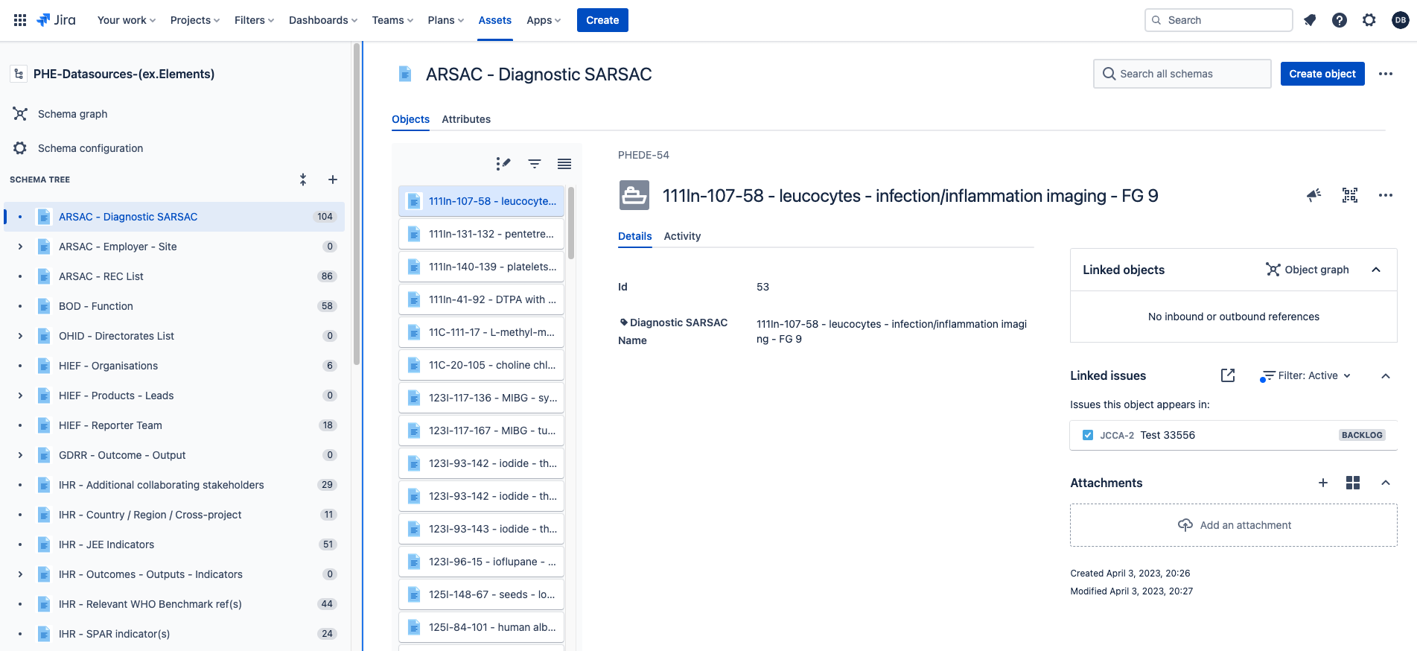
Assets Structure
©2022 Valiantys. All rights reserved.

Slide 5
Adjust the Asset values manually
Go to PHE-Datasources (ex.Elements) object schema
Find the Object Type that you want to update
Edit the Object Type and change the label attribute
Add/Remove object
©2022 Valiantys. All rights reserved.

Slide 6
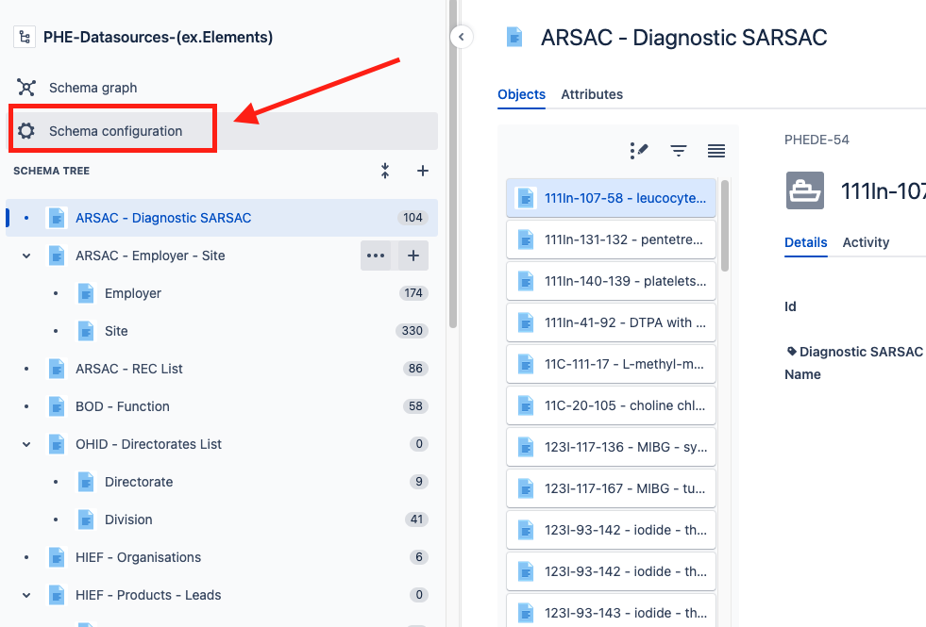
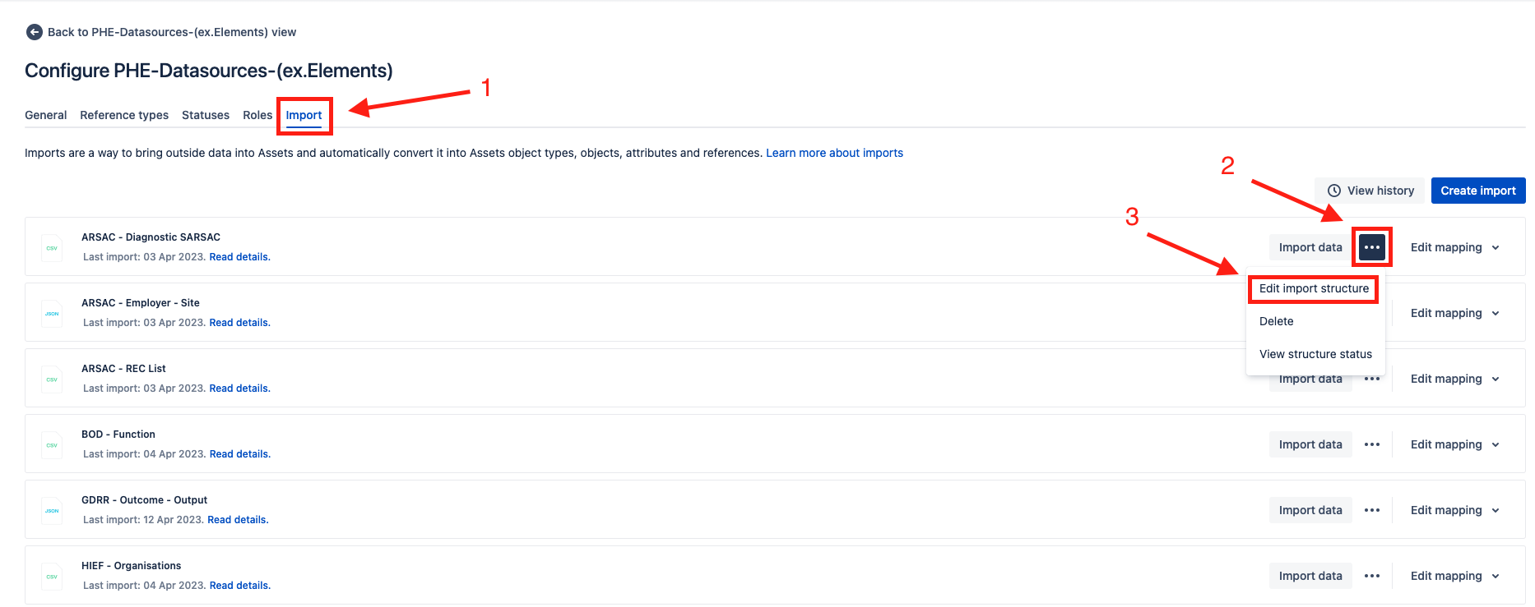
Import Files into Assets
©2022 Valiantys. All rights reserved.

Slide 7
Adjust Interconnected Asset Objects
Some Asset objects are interconnected
  e.g. based on the value of the program the user gets specific Labs
Assets are using the labels to connect objects together, so the labels need to exist in the child object
Ensure that you adjust those values in the files before you import them
©2022 Valiantys. All rights reserved.

Slide 8
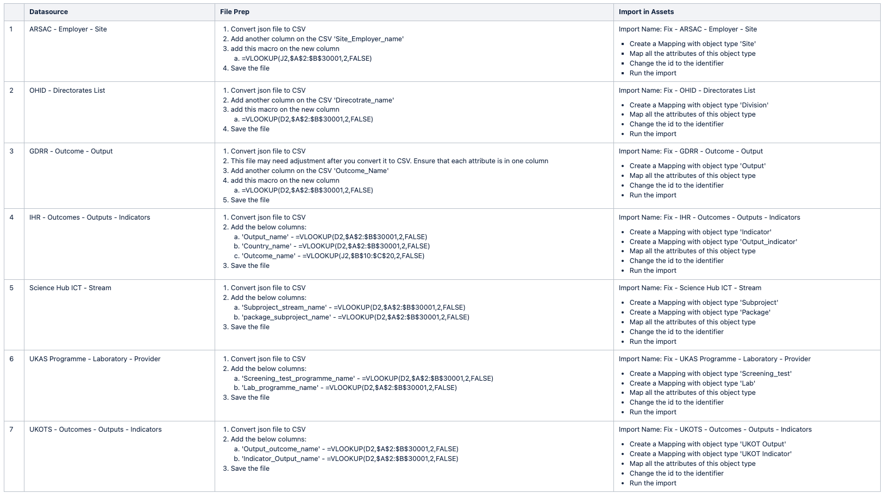
Adjust Interconnected Asset Objects
©2022 Valiantys. All rights reserved.

Slide 9
THANK YOU!
About Valiantys
Valiantys is the leading global consulting and services firm dedicated to Atlassian. We accelerate business transformation by digitizing processes and modernizing teamwork, using the best Agile methods and tools. Our Atlassian technical expertise is unparalleled, and we support our customers across the entire spectrum of their projects on those platforms. Because teamwork requires more than just tools, we help them bridge the gap between their applications and strategic practices such as SAFe and ITIL. Over the last 15 years, we have helped in excess of 5,000 customers to achieve their desired business outcomes at a reduced time to value, through improved team collaboration.
Find out how we can help you get the results you need at http://valiantys.com/
©2022 Valiantys. All rights reserved.

