Slide 1
Atlassian Consolidation
(Jira and Confluence):
Engagement Toolkit
June 2023

Slide 2
Navigating this Engagement Toolkit
Guide to finding the information you need
Using this Engagement Toolkit |  | The Headlines |  | Impacted Persona Groups |  | Overview of Impacts |  | Support & Readiness Resources
3 | Introduction | 8 | Atlassian consolidation video - Giulio Saggese | 16 | Introduction to Personas | 31 | Introduction to understanding impacts | 36 | Building readiness to go-live
4 | Video guide | 9 | UKHSA Global strategic priorities | 17 | Personas overview | 32 | Defining impacts by Persona | 37 | Support and guidance quick links
5 | Key message framework guidance | 10 | The role of Technology | 18 | Persona profile: Leadership | 33 | Exploring high level impacts | 38 | User Acceptance Testing (UAT)
6 | Key message framework | 11 | Consolidating Atlassian tools - Raj Metha | 20 | Persona profile: Site Administrators | 34 | Want to know more? | 39 | Familiarisation sessions
 |  | 12 | Overview of changes | 22 | Persona profile: Halo Service Operations
 |  | 13 | Overview of benefits | 24 | Persona profile: PHE Projects & End Users
 |  | 14 | T-Minus Plans | 26 | Persona profile: Test & Trace projects and users
 |  |  |  | 28 | Persona profile: External users, partners, vendors

Slide 3
Introduction
How to use this Engagement Toolkit
What is the Engagement Toolkit for?
Who should use it?
How to get the most from it?
The clue is in the name!
You have told us through the User Readiness Survey that there is not sufficient visibility of what this change is about and how it impacts people.
The information in this Toolkit is intended to:
Equip leaders and their teams with the information required in an intuitive and self-serve format
Empower stakeholders to have active and informed discussions around the change
Align thinking and minimise confusion
Build confidence and readiness for change across all user groups
Pose questions around tool usage to identify potential change risks
Anyone that has a key role in the following tools:
Jira
Confluence
Intended audience groups are defined as:
Leadership roles
Tool Administrators
PHE projects and Jira/Confluence users
Test & Trace projects and Jira/Confluence users
Halo Service Operations
External users, partners and vendors
This Engagement Toolkit will be sent to key roles defined
Those roles will be invited to a Briefing / Q&A Session where we will go through the content
Ask questions and let us know what else you might need
Use the materials provided to brief your teams
Each section has guidance on how best to use it and communicate it
Continue the conversation! Feed questions, concerns and any potential risk areas back to us via the User Query Form

Slide 4
Video guide
How to get the best from this Engagement Toolkit
Welcome and thank you for your interest in the Atlassian consolidation project which is focused on bringing together all Jira and Confluence data and users together onto a single UKHSA Cloud platform
This Engagement Deck aims to provide leaders with the information and materials required to brief their teams on what this change will mean to them and how to prepare
It also includes sections to share with teams that allow users to explore exactly how they will be impacted by the various technical adjustments to apps, plug-ins and integrations that work currently with Jira/Confluence
Let me walk you through how the Toolkit is structured

Slide 5
Key message framework
Purpose and guidance for use
The Key Message Framework:
Aligns the understanding of the project team and senior leadership on how to communicate around a change
Creates consistency and clarity across all communications and engagement content
Can be used to equip leaders as a tool for effective team engagement
Acts as a reference guide and foundation stone for all communications and engagement materials
Is not to be used as a communication output in its basic form
Creates line of sight from the project ‘case for change’ to the strategic objectives and headline benefits of the department or organisation it sits within

Slide 6





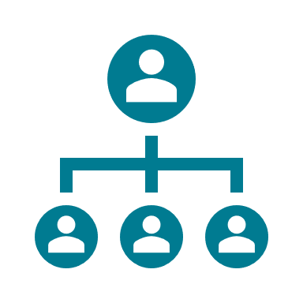
Key message framework
Foundational messaging for communications and stakeholder engagement
Strategic alignment
UKHSA strategic objectives
Prepare for future health security hazards
Save lives and reduce harm through effective health security response
Strengthen health security capability
Technology objectives
Build a world-class infrastructure
Remove barriers in Workforce Tools & Collaboration
Future strategic technology architecture with lower run cost
Sustainable VfM Resourcing & Operating Model
Right-level service management and operations process
Support transition to target Technology Operating Model
Technology Consolidation
Why
the change?
The future UKHSA is dependent on a technology and tools infrastructure that is efficient, reliable and sets clear processes and consistent ways of working across all our teams. Since bringing together the former Public Health England (PHE) and Test & Trace (T&T) organisations, UKHSA inherits a technology landscape that is complex, fragmented and duplicates effort. This means it is often inefficient, costly and is not fit for our future user needs.
What
is the vision?
All teams across UKHSA work with technology and tools in a consistent way with fast, secure and efficient access through Single Sign-On (SSO) and their unified UKHSA identity. Teams are able to collaborate seamlessly through use of a consolidated and optimised tool offering and we foster a culture for innovation and continuous improvement.
There are clear and streamlined escalation routes for service related issues.
How
will this be achieved?
People:
Teams embrace functionality changes to tools they use as an opportunity to work more collaboratively as one UKHSA. Guidance and training is provided to support colleagues and external stakeholders in adopting adjustments to ways of working.
Process:
Standardised ways of working within the Jira, Confluence and Git Hosting tools that we use. These take effect within service desk management, project management and software development as well as reporting and decision making.
Technology:
Consolidation of Jira, Confluence and Git Hosting within the Cloud creating functionality changes and impacting some plug-in applications. We are working to deliver these changes with minimal downtime and disruption.
Benefits
Improved security
Unified support model with singular escalation paths
Reduced technology running cost
Issues are resolved more quickly
Quicker and more efficient sign-on process through SSO
Increased productivity through enhanced collaboration

Slide 7
The Headlines

Slide 8

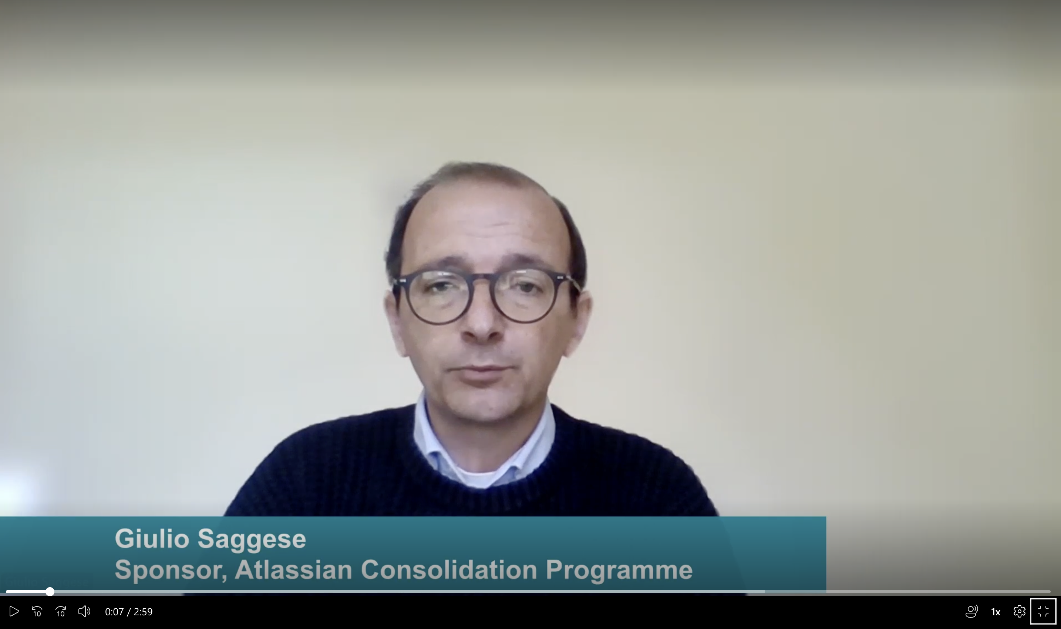

Why are we consolidating Atlassian tools?
Sponsor video: Giulio Saggese

Slide 9



UKHSA Global Strategic Priorities
Driving our Global Vision (Jan 2023 Global Health Strategy Advisory Board)
UKHSA expertise at the forefront of preparing, responding and building global efforts to strength health security
PREPARE: Strengthen Global Preparedness
Strengthen global preparedness for risks to public health posed by infectious diseases, anti-microbial resistance (AMR), chemical, biological, radiological, nuclear (CBRN), and climate & environmental factors. Enhance global resilience and capability, particularly in fragile health systems.
RESPOND: to Global Health Threats
Actively respond to global health threats, including deploying to health emergencies to save lives and reduce harm to society.
BUILD: UKHSA capability and scientific & industry partnerships
Maximise the contribution of UKHSA science and build the capability we need internally and as a system through scientific and industry partnerships in support of vaccines, therapeutics and diagnostics and clinical trials.

Slide 10






Technology plays a central role in UKHSA strategy
Technology’s strategic objectives
MARKETING STRATEGY
05
Build a world-class infrastructure
Remove barriers in Workforce Tools & Collaboration
Future strategic technology architecture with lower run cost
Sustainable value for money resourcing and operating model
Right-level service management and operations process
Support transition to target Technology Operating Model
Atlassian Consolidation: Engagement Toolkit

Slide 11
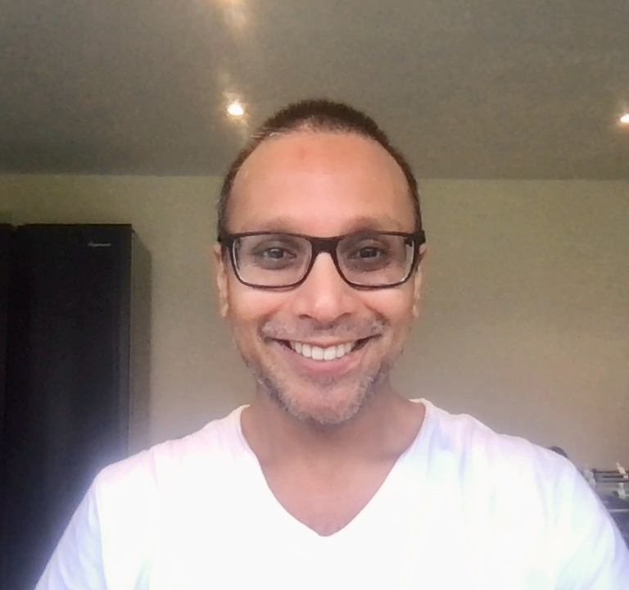
Consolidating our Atlassian tools
Raj Metha explains the reasons for change and his vision for the future
Welcome to Our Journey to Future-Fit Technology with Lower Run Cost
"Since bringing together the former Public Health England (PHE), NHS Test & Trace (T&T) and Joint Biosecurity Centre (JBC) organisations, UKHSA inherits a technology landscape that is complex, fragmented and duplicates effort.
This means it is often inefficient, costly and is not fit for our future user needs.
A core objective of my role as DD of Development & Operations is to establish a world-class technology offering within the increasing demand to deliver more for less.
Our vision is to provide UKHSA with a technology and tools infrastructure that is efficient, reliable and sets clear processes and consistent ways of working across all our teams."

Slide 12



How will we make this happen?
A high level overview of what changes to expect
PUZZLE INFOGRAPHIC
People
Teams will need to embrace functionality changes to tools they use as an opportunity to work more collaboratively as one UKHSA.
Guidance and training is provided to support colleagues and external stakeholders in adapting to changes in ways of working.
Technology
Consolidation of Jira, Confluence and Git Hosting within the Cloud creating functionality changes and impacting some plug-in applications.
We are working to deliver these changes with minimal downtime and disruption.
Data
A degree of ‘house-keeping’ will be completed before former PHE and T&T data is migrated to the Cloud. Duplicates will be fixed and any unused or inactive spaces that is no longer required will be moved to archive.
Process
Standardised ways of working within the Jira, Confluence and Git Hosting tools that we use.
These take effect within service desk management, project management and software development as well as reporting and decision making
Atlassian Consolidation: Engagement Toolkit

Slide 13

What benefits and outcomes will we see?
Why we all need to get behind this change
BUSINESS INFOGRAPHIC
Improved Security
Reduced run cost
The Cloud offers increased assurance around the storage and management of UKHSA data
Consolidating our data, applications, plug-ins and integrated tools brings long term financial efficiencies
Increased productivity
Quicker access
Teams will be able to collaborate more freely, with less barriers to sharing information, ideas and insights
Sign-in process will be quicker and more efficient for all users through Single Sign-On (SSO)
Unified support model
Increased agility
A single support model with consolidated processes, policies and escalation paths
Moving to the Cloud means we are more ready for future releases of new functionality and able to innovate more easily
Atlassian Consolidation: Engagement Toolkit

Slide 14
T-minus plan
PHE / NTBS Jira and Confluence users
 | T-9 5/6 | T-8 12/6 | T-7 19/6 | T-6 26/6 | T-5 3/7 | T-4 10/7 | T-3 17/7 | T-2 24/7 | T-1 31/7 | T0 7/8 | T+1 14/8 | T+2 21/8 | T+3 28/8 | T+4 4/9 | T+5 11/9
Technical & Testing Milestones
QAT & UAT
Change & Comms
Hot topics |  | Sponsor video / change freeze / FAQ | Personas / Impact Maps / Pulse check | Launch user update newsletter | Pulse page and drop-in | UKHSA News, two-week delay | You said, we did | Countdown: Readiness checklists | Countdown: Training and familiarisation | Countdown: Do you feel ready? | Countdown Support | Go-live FAQ / Reinforce training and support routes | Go-live FAQ / Reinforce training and support routes | User feedback
Learning & Support
Staging dry-run
MIGRATION
MIGRATION
Prepare data for migration to Staging
Go-live
Technical hyper-care
Change freeze – level 1
No new configuration items (custom fields, workflow automations, scripts and add-ins), new users must be added to active directory, new projects must be verified
UAT set up – scripts, testers and schedule sessions
QAT
UAT on Cloud
Engagement Toolkit live
Readiness Pulse check
Readiness Pulse check
User feedback survey
Change management playbook: transition planning and handover
Multi-channel campaign: awareness and impacts
Departmental Town Halls campaign
Multi-channel readiness campaign
Go-live comms campaign
SLT
Tech town hall
UC/leader Briefings
DAS town hall
SLT readiness update
UC/leader briefings
Readiness briefings
Tech town hall
UC/leader briefings
Feedback focus
Weekly drop-in sessions
Supplementary learning: apps, plug-ins and integrations
Familiarisation sessions / Lunch & Learns
New support model live?
Build User Communities
Cloud training phase 1: UAT Testers
Cloud training phase 2:
Service Desk
Cloud training phase 3:
All users
Check-Point
Check-Point
GO/NO-GO
PHE Go-Live
NTBS Go-Live

Slide 15
Impacted Persona Groups

Slide 16
Introduction to Personas
What is a Persona and how do they help us?
The changes associated with the Atlassian Consolidation vary from team to team.
This is because of the wide-ranging applications, plug-ins and integrations that different teams use, as well as the localised ways in which colleagues use the tools themselves.
Grouping users into categories according to their role in the change helps us to tailor communications and readiness plans according to their needs.
This means that colleagues impacted by the changes only hear the information they need and have a readiness plan that is relevant and tailored for them.
This section breaks information into six key Persona groups.

Slide 17
Personas overview
The core role groups identified as impacted by change
Select the Persona group that best applies to you.
This will take you to your Persona Profile which provides the following information:
About you and your role within the Atlassian Consolidation change
Summary of whats in it for you and the benefits relevant to your role
Summary of the impacts you may experience
A Readiness Checklist to help you prepare
Leadership
Halo Service Operations
T&T Projects & End Users
Site Administrators
PHE Projects & End Users
External Users, Partners, Vendors

Slide 18
Persona Profile: Leadership
Needs to understand the change so they can actively endorse within their team, function or project
About me
My role:
I hold a senior leadership role in former PHE or T&T
I am a programme/project sponsor or manager
I head up a department or large team
What is important to me:
Having a clear and accurate view of performance, delivery and risks that equips me to make confident decisions
My team feeling empowered to conduct their work seamlessly and without disruption
Tools that are reliable, intuitive and meet the needs of our customers
The happiness of my team
Preferred channels:
SLT meetings
Direct engagement where required
Regular updates on progress
Impacts
What's in it for me:
Tools that support the future of UKHSA as one unified organisation
Standardised ways of working that drive financial and operational efficiency
Impacts I may experience:
Changes to dashboards, trackers or reports that may require reconfigure
Short-term dip in productivity as teams adapt to new Cloud version and adjustments to functionality
Potential for external customers, partners or vendors to need reassurance and support
Potential for additional demand on team resources due to some rework or reconfigure of document links, archives or ticket management
I am a departmental or project lead, with responsibility for business operations, performance or delivery
I want to understand how this change aligns with broader business strategy and what it means to means to my department, team or project

Slide 19
Readiness Checklist
Leadership
As a leader, I play a crucial role in preparing my team for the change. I will do so by cascading relevant information and updates, and in providing reassurance, and highlighting any issues that may arise
Know and understand how to communicate the change to your team using the Key Message Framework
Provide a briefing and Q&A for your team using the Engagement Toolkit
Join the User Community to keep up to date with latest news and readiness activities
Keep the conversation going through team meetings, cascading information on progress
Encourage engagement in the Pulse Checks, and keep an eye out for readiness updates
Make time for SMEs within your team to participate in UAT, so any local reports, dashboards and specific use cases can be assured

Slide 20
Persona Profile: Site Administrators
Requires detailed understanding of technical, process and user experience changes so they can guide local teams and triage issues
About me
My role:
I am a designated administrator license holder for Jira and/or Confluence
I am the key point of contact for changes, advice or guidance in use of these tools for those within my team
I have a key role in the migration of data and recreation of links in Confluence and Jira.
What is important to me:
Having a detailed understanding of how the tools work, the definitions and rationale that sit behind what the user sees on screen
Being able to triage and resolve issues quickly without having to raise a ticket
Preferred channels:
Technology Newsletter
Direct emails
Regular technical briefings on progress and business decisions
Impacts
What's in it for me:
Consolidated ways of working across teams and functions that support better collaboration
Some upgrade to apps and integrations
Future functionality upgrades as the Cloud offering evolves
Impacts I may experience:
Changes to dashboards, trackers or reports that may require time and effort to reconfigure
User issues that will require technical fix
Users requiring support and guidance as they adapt to new ways of working
Changes to drop-down options, definitions, iconography, look and feel and certain system behaviours
Minor process change associated with move to Assets (Insight) from Elements Connect
Effort during the migration migrate data using Atlassian tools, some manual migration and recreation of links, dashboards and reports.
I am a Subject Matter Expert (SME) and play a key role in understanding the business needs of the projects and teams I am responsible for
I want to understand the detail and specifics of both the technical side of the consolidation as well as any user experience changes

Slide 21
Readiness Checklist
Administrators
Join the User Community to keep up to date with latest news and readiness activities
Work with your team/s to identify any specific use cases that will require testing in UAT
Provide feedback – let us know how we’re doing and if you need anything
Complete the training
Work with your Project Lead and/or departmental lead to keep the conversation going in your team meetings, cascading key updates and hosting Q&A
Engage with the Pulse Check surveys to help us track readiness
Please follow the Jira Cloud REST API documentation and the Confluence Cloud REST API documentation so that you can adjust any REST calls accordingly post migration.
Make sure you generate an API token following the process here.
As a licenced administrator, I have the best view of what the changes to Jira and Confluence will mean for my projects and teams.
I have a crucial role in translating the impacts for my colleagues.

Slide 22
Persona Profile: Halo Service Operations
Require detailed understanding and mitigation planning across all technical and UX changes impacting service management and T&T users
About me
My role:
I work as part of the Halo team, responsible for the technical service initiated by the Test & Trace organisation
I work within the service operations desk.
What is important to me:
I want to be aware of what is changing ahead of time so that I can ensure that my work is not disrupted when the changes are made.
I rely heavily on Jira and Confluence, so any differences between server and cloud have the potential to disrupt my work.
Preferred channels:
Slack
Town Halls
Direct engagement where required
Impacts
What's in it for me:
Better housekeeping – removing unused apps and plug-ins.
Quicker and more efficient sign-on process through SSO
Impacts I may experience:
Some apps, plug-ins and integrations will not be available in the Cloud.
Those that are still available may display a reduced functionality compared to Jira server.
The current use of most affected apps is very light touch, this means that either another app can be used or the changes are of no impact.
There will be alterations in look and feel within the tools
I work within the Halo Service Team providing technical service and support to the Test & Trace user community
Jira and Confluence are tools I use as key part of my daily work. They are central to project work, service desk management and technical support

Slide 23
Readiness Checklist
Halo Service Operations
I have a technical view of Confluence and Jira and my role so far has been answering tickets raised within Test and Trace. As a result I have a crucial role in translating the impacts for my colleagues.
Check downstream reporting and let us know if you have any concerns related to the following
Check impacts listed as outputs of the impact assessment workshops and validate.
If you have significant dependency on Jira and/or Confluence and use either in a way that is customised to a specific process, please volunteer for UAT
Brief your team using the materials in this Engagement Toolkit
Complete the training

Slide 24
Persona Profile: PHE Projects & End Users
Impacts vary depending on local usage. Require visibility of all potential impacts to establish and manage risk of disruption.
I am a regular user of Jira and/or Confluence as part of one or more UKHSA projects, business or customer processes or work teams.
About me
My role:
I sit within any one of the former PHE functions
I play a key role in the day-to-day activities within a project or business process
What is important to me:
Intuitive and efficient tools that support the day-to-day management of the project
Active collaboration across the team with minimal risk of version control issues, confusion or duplication of effort
Preferred channels:
Pulse
Teams channels
Town Halls
Direct engagement where required
Impacts
What's in it for me:
Increased productivity through enhanced collaboration
Quicker and more efficient sign-on process through SSO
Impacts I may experience:
There will be minor changes to drop down options, icons, project key, status or naming ahead of the main migration – the specific impacts will vary project-to-project
Dashboards, local data
Behaviours within workflows and/or Jira Service Management
Minor functionality or user experience changes as a result of some apps being replaced
General look and feel changes related to the Cloud version of the tools
I have a vested interest in the success of this migration in order to avoid disruption to my day-to-day work and delivery commitments

Slide 25
Readiness Checklist
PHE Projects & End Users
The specific impacts to functionality will depend on which team I work within.
Using the impact assessment materials will be key to understanding which changes will be applicable.
Join the Teams User Community to keep up to date with latest news and readiness activities
Work with your local Administrator to identify any specific use cases that will require testing in UAT (e.g. dashboards, reports, service desk project requirements)
Attend the Thursday drop-in sessions with any questions and to provide feedback
Complete the training
Engage with the Pulse Check surveys to help us track readiness
If your project uses behaviours check the detailed analysis for PHE and on which Behaviours will be available in Cloud, for which of them we need to apply a workaround and what are the limitations and the impact.

Slide 26
Persona Profile: T&T Projects & End Users
Impacts vary depending on local usage. Require visibility of all potential impacts to establish and manage risk of disruption.
I am a regular user of Jira and/or Confluence as part of one or more UKHSA projects, business or customer processes or work teams.
About me
My role:
I sit within any one of the former Test & Trace functions
I play a key role in the day-to-day activities within a project or business process
What is important to me:
Intuitive and efficient tools that support the day-to-day management of the project
Active collaboration across the team with minimal risk of version control issues, confusion or duplication of effort
Preferred channels:
Slack
Direct engagement where required
Impacts
What's in it for me:
Increased productivity through enhanced collaboration
Quicker and more efficient sign-on process through SSO
Impacts I may experience:
There will be changes to drop down options, icons, project key, status or naming ahead of the main migration – the specific impacts will vary project-to-project
Further instances of drop-down and icon changes at migration to align with broader UKHSA ways of working
Dashboards, filters or local analysis solutions fed by Jira may change
Behaviours within workflows and/or Jira Service Management
Minor functionality or user experience changes as a result of some apps being replaced
General look and feel changes related to the Cloud version of the tools
I have a vested interest in the success of this migration in order to avoid disruption to my day-to-day work and delivery commitments

Slide 27
Readiness Checklist
Test & Trace Projects and End Users
The specific impacts to functionality will depend on which team I work within.
Using the impact assessment materials will be key to understanding which changes will be applicable.
Join the Teams User Community to keep up to date with latest news and readiness activities
Work with your local Administrator to identify any specific use cases that will require testing in UAT (e.g. dashboards, reports, service desk project requirements)
Attend the Thursday drop-in sessions with any questions and to provide feedback
Complete the training
Engage with the Pulse Check surveys to help us track readiness
If your project uses Behaviours, check the analysis for Halo on which Behaviours will be available in Cloud, for which of them we need to apply a workaround and what are the limitations and the impact.

Slide 28
Persona Profile: External users, partners, vendors
Require direct engagement and visibility of all potential impacts to establish how individual teams will experience the change
About me
My role:
I sit within the DHSC organisation, as part of the Office for Health Improvement & Disparities (OHID) or similar
What is important to me:
Continuation of service for Jira and Confluence – being able to do what we can today without disruption
Preferred channels:
Cascade of information via designated contacts
Impacts
What's in it for me:
Increased productivity through enhanced collaboration
Quicker and more efficient sign-on process through SSO
Impacts I may experience:
There will be minor changes to drop down options, icons, project key, status or naming ahead of the main migration – the specific impacts will vary project-to-project
Dashboards, local data
Behaviours within workflows and/or Jira Service Management
Minor functionality or user experience changes as a result of some apps being replaced
General look and feel changes related to the Cloud version of the tools
Potential change in policy and process associated with access and security (Joiners, Movers, Leavers)
I am a user of Jira and/Confluence sitting outside of the UKHSA structure.
I want visibility of what changes are ahead, and reassurance that as ‘external users’, we will not experience any major disruption to the way we use Jira and Confluence

Slide 29
Readiness Checklist
External users, partners and vendors
The specific impacts to functionality will depend on which team I work within.
Using the impact assessment materials will be key to understanding which changes will be applicable.
Work with your local Administrator to identify any specific use cases that will require testing in UAT (e.g. dashboards, reports, service desk project requirements)
Join the Teams User Community to keep up to date with latest news and readiness activities
Attend the Thursday drop-in sessions with any questions and to provide feedback
Complete the training
Engage with the Pulse Check surveys to help us track readiness

Slide 30
Overview of Impacts

Slide 31
Introduction to understanding impacts
What is change impact assessment?
Change is often not what it seems at first glance!
The Atlassian Consolidation might sound like a straightforward technology change, but it impacts people in a number of different ways.
In this section you can explore the impacts in more detail, according to the perspectives and experience of our six Persona groups.

Slide 32
Articulating high level business impacts
Through use of a Persona-based approach
Although the Atlassian Consolidation is primarily a technology-driven initiative, it will impact individuals and teams in a range of ways.
We conduct this high level change impact assessment in two steps.
1
Defining impacted groups by Persona
Grouping individuals and teams into a Persona that represents what role they will need to play in the change and how they might view it, as opposed to their BAU role.
2
Articulating impacts by change type
People experience and respond to change in a range of ways. We must understand and quantify the impacts of change in a complete and holistic manner to shape an effective change plan.
People
Working culture and collaboration
Mindset and behaviours
Skills and learning
Leadership
Halo Service Operations
T&T Projects / End Users
Process
Business process
Governance
Technology
Administrators
PHE Projects / End Users
External Users, Partners, Vendors
Systems and tools
Reporting and insights
View the framework for change impact assessment in the Appendix

Slide 33
High level change impact assessment
An overview of how change impacts key Persona groups, and the accompanying messaging and risk profile
No Impact (0)
Low Impact (1)
Medium Impact (2)
High Impact (3)
Persona | Total Impact Score | PEOPLE |  |  | PROCESS |  | TECHNOLOGY
Persona | Total Impact Score | Culture & Collaboration | Mindset & Behaviours | Skills & Learning | Process | Governance | Systems & Tools | Reporting & Insights
Leadership Leaders of departments, Teams or projects
Site Administrators Site level Administrator Support role
Halo Service Operations Managing and supporting existing T&T service
PHE Projects & End Users User located within existing former-PHE instance
T&T Projects & End Users User located within existing former-T&T instance
External users, partners & vendors DHSC / OHID user or Partners outside of UKHSA organisation
10
14
12
11
12
11

Slide 34
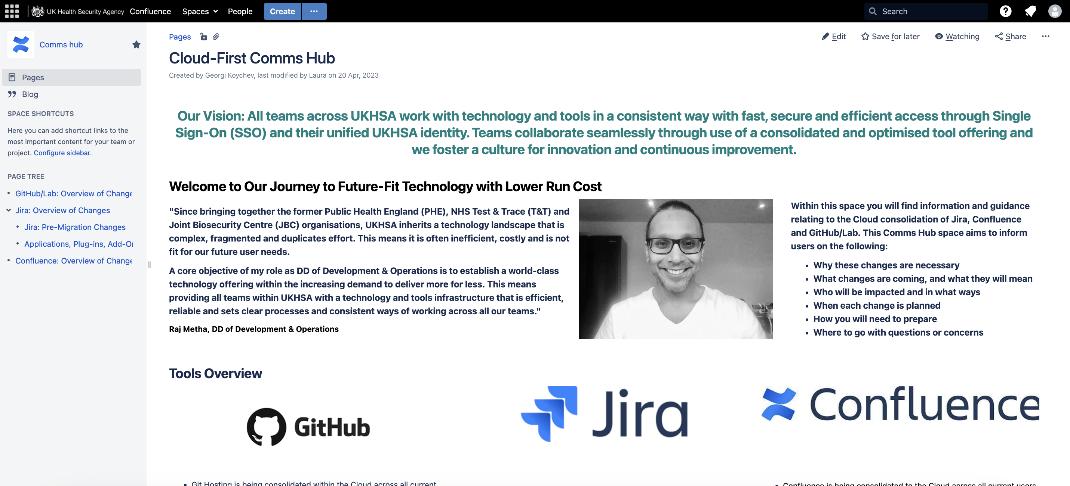
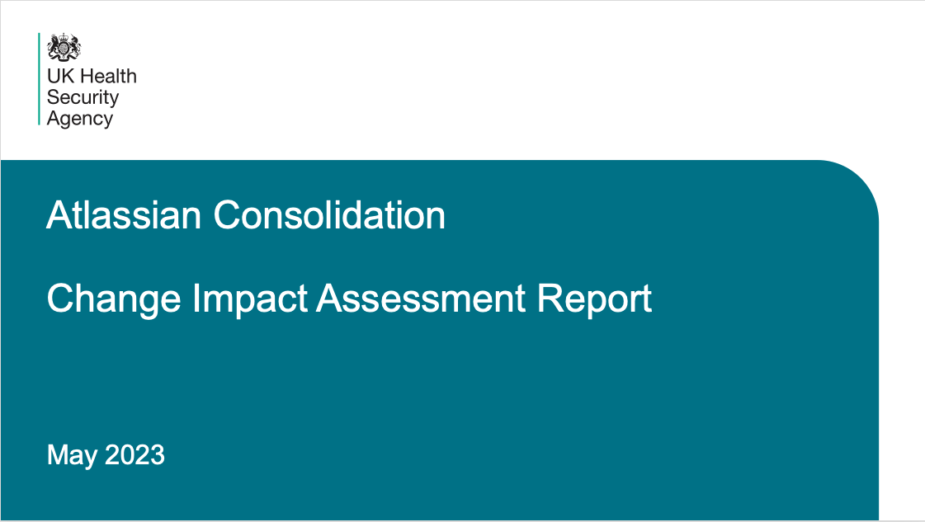
Want to know more?
Click the tiles below to explore the detailed impacts from changes to apps, plug-ins, integrations

Slide 35
Support & Readiness Resources

Slide 36
Building readiness to go-live
Introduction to the support available
We’re in this together!
Over the coming weeks, we’ll be working with you to give you all the information, guidance and support you need to feel confident before we move to Cloud.
What we ask of you:
Engage: read communications and the materials provided
Feed back: let us know how we’re doing via the Pulse Check surveys or just drop us a line
Get involved: in UAT, the User Community and in training
Ask questions: if you’re concerned or not sure about something

Slide 37
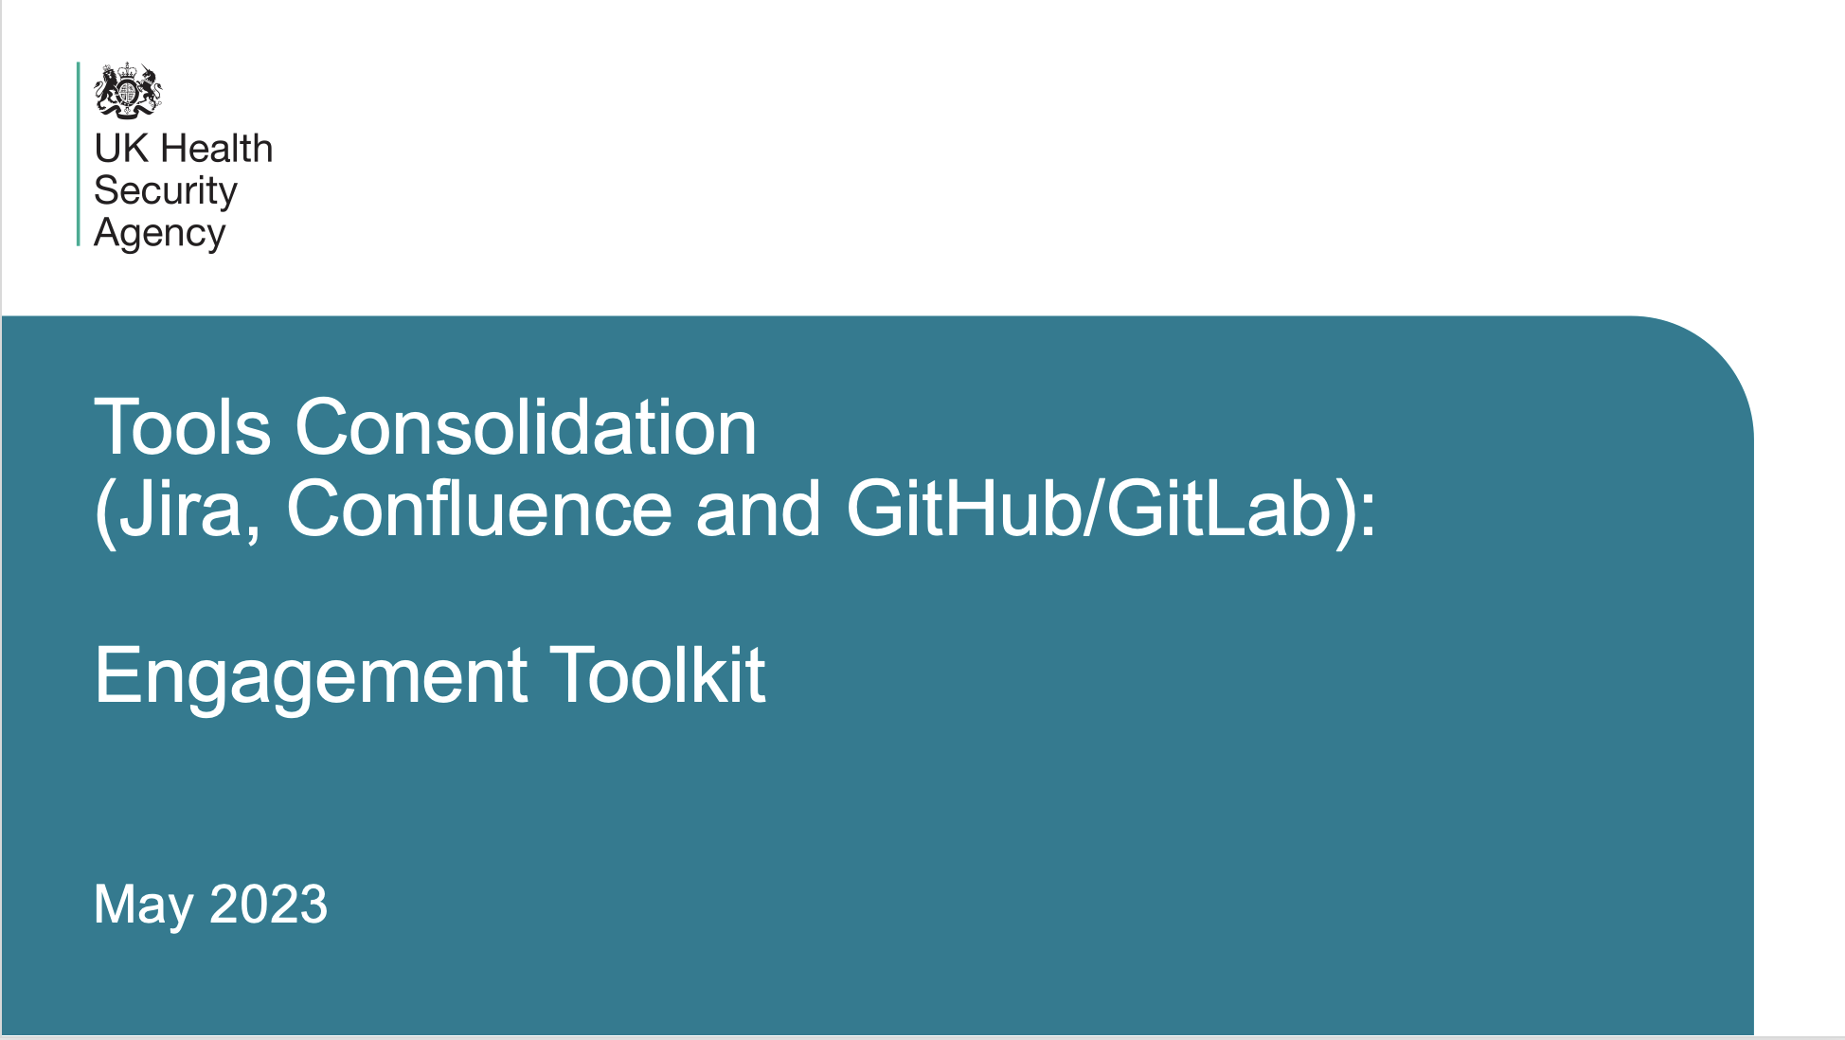




Support and guidance
Click the tiles for more information
Comms Hub
(Confluence)
Engagement Toolkit
Training Hub
COMING SOON
User Community Channel (UKHSA & DHSC)
User Community Channel (T&T)
Drop-In Sessions
(Thursdays at 12:00)
atlassian

Slide 38
User Acceptance Testing
The role of UAT in successful technology change
One of the best ways to safeguard against disruption with any form of technology change is User Acceptance Testing (UAT)
If you use Jira or Confluence in any business critical process, reporting-centric or weird and wonderful way, we want to hear from you.
Please let us know your specific use cases and volunteer a small amount of time to help us test it will work as required in Cloud.
Sign up here!

Slide 39
Familiarisation Sessions
The role of UAT in successful technology change
User Acceptance Testing (UAT) will happen in 3 stages over two weeks
Stage 1 – For Users of impacted applications and add ons – these will consist of 30 min meetings for small groups of users to log into the system and test specific areas.
Stage 2 – For Users in priority areas like external users you will be invited to 30 minute sessions in small groups.
Stage 3 – For all remaining Users you will be invited to 1 hour drop in sessions for 20-30 users to access the cloud and check out how their projects will look after the migration.
Placeholders for these meetings will go out shortly – we will try to be flexible if you can’t make a session please let us know and we will try to move you to a different session within the two week period.

Slide 40
Appendix

Slide 41
Change Impact Assessment Framework
A structured approach to quantifying impact
 | People |  |  | Process |  | Technology
 | Working Culture & Collaboration | Mindset & Behaviours | Skills & Learning | Business Process | Governance | Systems & Tools | Reporting & Insights
1. Low Impact | Minor disruption to working culture and the ability to work together | Minor adjustment to existing beliefs around the way things should be done | Minor change to learning needs in existing roles due to altered competency or skill requirements | Adjustments to existing business process | Minor change to existing governance requirement or business decision making | Upgrade to existing system or tool introducing new or additional functionality | One-off or redesign of existing information requirements (for processing, analysis or reporting)
2. Medium Impact | Moderate culture shift and/or change to collaboration requirements | Moderate change to the way one or more key role groups think and behave around a topic | Moderate change to core competencies within existing roles, requiring new or additional leaning pathways | Change to existing business processes or new business process with up to 50% change to activities, workflows or interfaces | New information or decision making requirements to an existing governance body | New system or tool, with moderately different functionality to support existing ways of working | New or additional information requirements for processing, analysis or reporting
3. High Impact | Paradigm shift in culture / potential misalignment between new teams or functions and/or ability to collaborate | A significant paradigm shift in belief structures and behaviour of multiple role groups | Roles require fundamentally different skills and competencies. Significant re-training and/or recruitment required | Multiple new business processes and/or >50% changes to activities and workflows | New governance body, process or stage gate requirements | New system or tool introduced to support completely new ways of working | Significant change to data sources, content or quality. >50% change to information requirements or business intelligence

